Slide 1


Session 9. T24 Release Methodology
T24 Technical Induction Training
Minsk, 2021

Slide 2




Agenda
T24 Life Cycle
Temenos Released components
T24 Update
T24 Upgrade

Slide 3
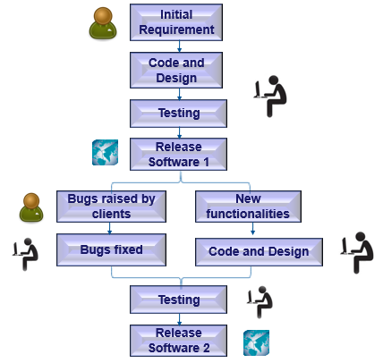

T24 Life Cycle
Notes:
Tired of doing things manually and with the invention of the computer, man started thinking of creating software for every possible walk of life. Software helps you work more effectively and accurately. Based on the requirement, the first step would be to design and code the software.
Testing to see if all is well is the next most important step. After this is done, the software is ready for use and can be implemented in real time.
Nothing in this world is perfect and neither is software. Using a software in most cases bring up issues with it, some simple and some critical. These are commonly referred to as bugs. Reported bugs are then fixed for the clients.
Every software evolves with time. There might be new enhancements or functionality changes which will result in updating the code and redesigning the software. These are then tested and released as an improvised version of the existing software.
Every new version of software is referred to as a release.
This is the vicious cycle all software goes through.
Similar to any software life cycle, T24 also has a life cycle. Temenos releases a new version of T24 every year with newer functionality to keep up with the growing demands of the market. This yearly release is internally called a GA release which stands for Generally Available release.
After the GA is released, Temenos will work towards releasing the next GA. But what if a client faces an issue with the GA it purchased? If reported the Development team will work to fix it and send a patch (a bug fix) back to them.
If the issue faced by the client is critical and not client specific, the bug fix is released to all clients who are using that GA in the form of a Service Pack.
To arrive at the next GA, internally Temenos releases monthly versions of T24 called Project Builds which may include bug fixes, new functionality or enhancements to the existing functionality. Even before the Project Build is released every month, it has to go through regression testing and build testing.
You must remember that each new Project Build comprises of all changes up to that point in time. After these tests are done, a new Project Build is now available internally in Temenos. The latest build is what further enhancements would affect. At the end of 12 months, the latest Project Build becomes the new GA.

Slide 4
Temenos Released components
Releases | Updates
Comprises of new functionalities, bug fixes and enhancements done in a year | Comprises of bug fixes only
Bundled as one unit | Bundled per component
Releases are done once a year | Daily
Naming convention is in the format RXX. Example: R18, R19 etc. | Naming convention product_component_seqno Example: AC_Statement_01
Notes:
Project Builds are released on a monthly basis which comprises of new functionalities, bug fixes and enhancements
PBs are named in the format YYYYMM where YYYY stands for the year of the build and MM for the month in which that particular build is released. Examples of Project Builds are 200702, 200809, etc..
Generally Available release is released once in a year.
GA is derived from one or more Project Builds.
Once GA is officially launched, no further enhancements done.
Naming convention is in the format RXX where XX stands for the year of release and 000 denotes that it is a GA release
Examples of GA release are R07, R08
If in case there are any critical issues to be fixed in a particular PB which cannot be postponed to the next PB, then multiple PBs for a single month can be released
Naming convention for multiple Project Builds is YYYYMM.NNN where YYYY stands for the year, MM stands for the month and NNN stands for the Nth release of the PB. Examples of multiple Project Builds are 200703.002 , 200703.006 etc., where the actual Project Build is 200703. This means that six multiple PBs have been released for one single month.

Slide 5
T24 Update
T24 Update provides bug fixes and minor software enhancements and is made available by free download
Update is sometimes called a software patch because it is applied over software that you already have installed
Update does not provide a full software package installation

Slide 6
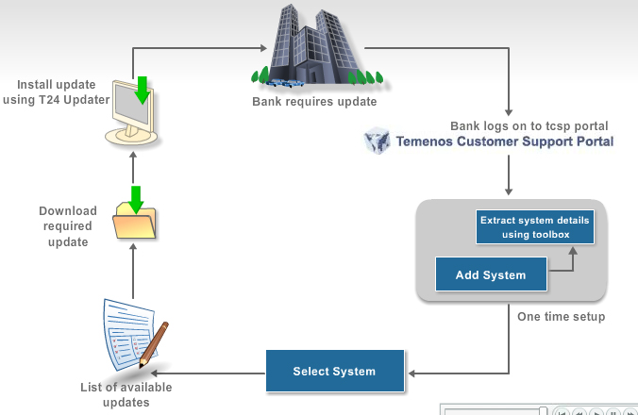
Update Processes
Notes:
This is an overview of how the T24 Updates system works.
The bank requires an update.
It can search for the updates in the Temenos Customer Support Portal (tcsp), provided the bank has registered with the tcsp.
After the registration, the bank should register its T24 system with the Temenos Customer Support Portal. This is a one time step. The system information (in the form of an xml file) should be extracted from the bank’s T24 Server using toolbox and with the extracted information, the T24 system can be registered with tcsp.
The bank should login to the tcsp, select the registered T24 system, check for available updates.
A list of available updates will be provided to the bank.
The bank may then choose an appropriate update, download and install it using the T24 updater tool.
For detailed explanation on every step, refer to the T24 Updates course.

Slide 7
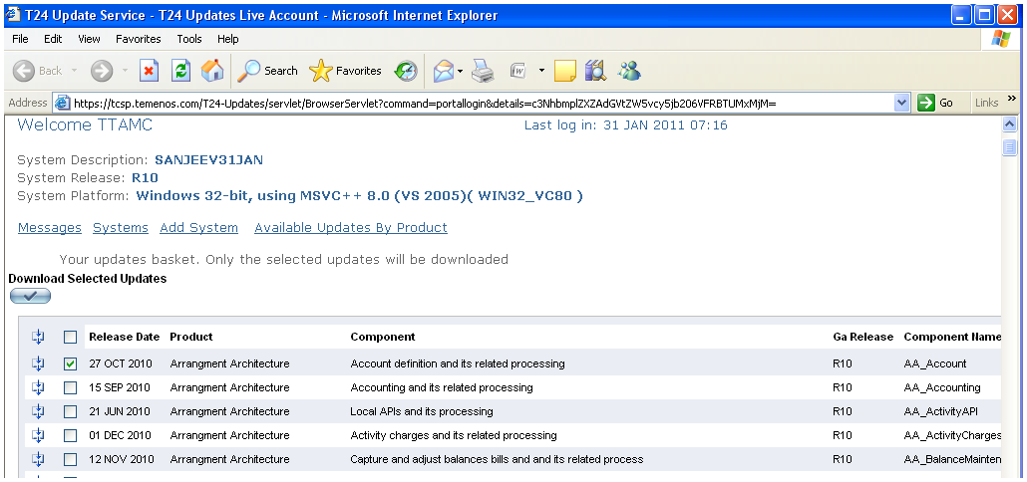
Update Processes
List of Updates on Temenos TCSP (tcsp.temenos.com)
Notes:
This is an overview of how the T24 Updates system works.
The bank requires an update.
It can search for the updates in the Temenos Customer Support Portal (tcsp), provided the bank has registered with the tcsp.
After the registration, the bank should register its T24 system with the Temenos Customer Support Portal. This is a one time step. The system information (in the form of an xml file) should be extracted from the bank’s T24 Server using toolbox and with the extracted information, the T24 system can be registered with tcsp.
The bank should login to the tcsp, select the registered T24 system, check for available updates.
A list of available updates will be provided to the bank.
The bank may then choose an appropriate update, download and install it using the T24 updater tool.
For detailed explanation on every step, refer to the T24 Updates course.

Slide 8
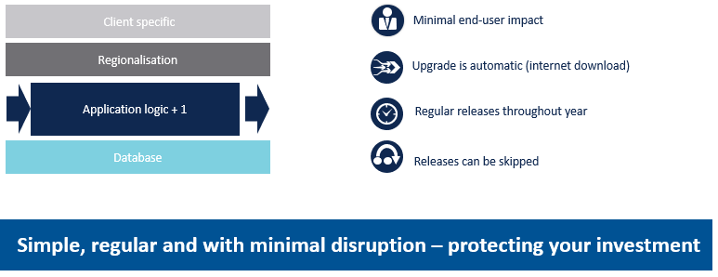
Upgrade
Notes:
Packaged, Modular, Upgradeable : the system has been designed from the beginning to be packaged, ensuring that Bank’s enhancements (Eg data model extensions) are fully protected during upgrade. (this is a key differentiator with old in-house legacy system)

Slide 9
Thank you for your time and attention!
FORANX LLC
Legal address:
35A, Ponomarenko str., 201 office, Minsk, 220015, Belarus
Tel.:+ 375 17 202 76 78
+ 375 17 202 76 79
Fax: + 375 17 362 34 22
Web-site: www.foranx.by
Minsk, 2021

